Slide 1
R User Group Kickoff
Building a community of R users in Connecticut state government
June 4, 2024

Slide 2
Agenda
Introductions
What is R?
Why use R?
R resources
Discussion
Demo
Next steps

Slide 3
Introductions

Slide 4

Notes:
Link to edit the form: https://forms.office.com/Pages/DesignPageV2.aspx?subpage=design&FormId=-nyLEd2juUiwJjH_abtzi5L_xJbiJ_5BoyF_jDckfpJUOUVLMzQ5UkhJMzM1NFlCQTlXWVVTV1JaMS4u

Slide 5
What is R?

Slide 6

What is R?
Programming language for statistical computing and data visualization
Open-source and free to use
Created by statisticians for statisticians

Slide 7
Key features of R
Statistical analysis: linear and nonlinear modeling, time-series analysis, classification, clustering
Data visualization: high-quality graphs and plots
Extensible with thousands of packages available
Comprehensive R Archive Network (CRAN) hosts user-contributed packages
Large and active user community
Extensive documentation and support available

Slide 8
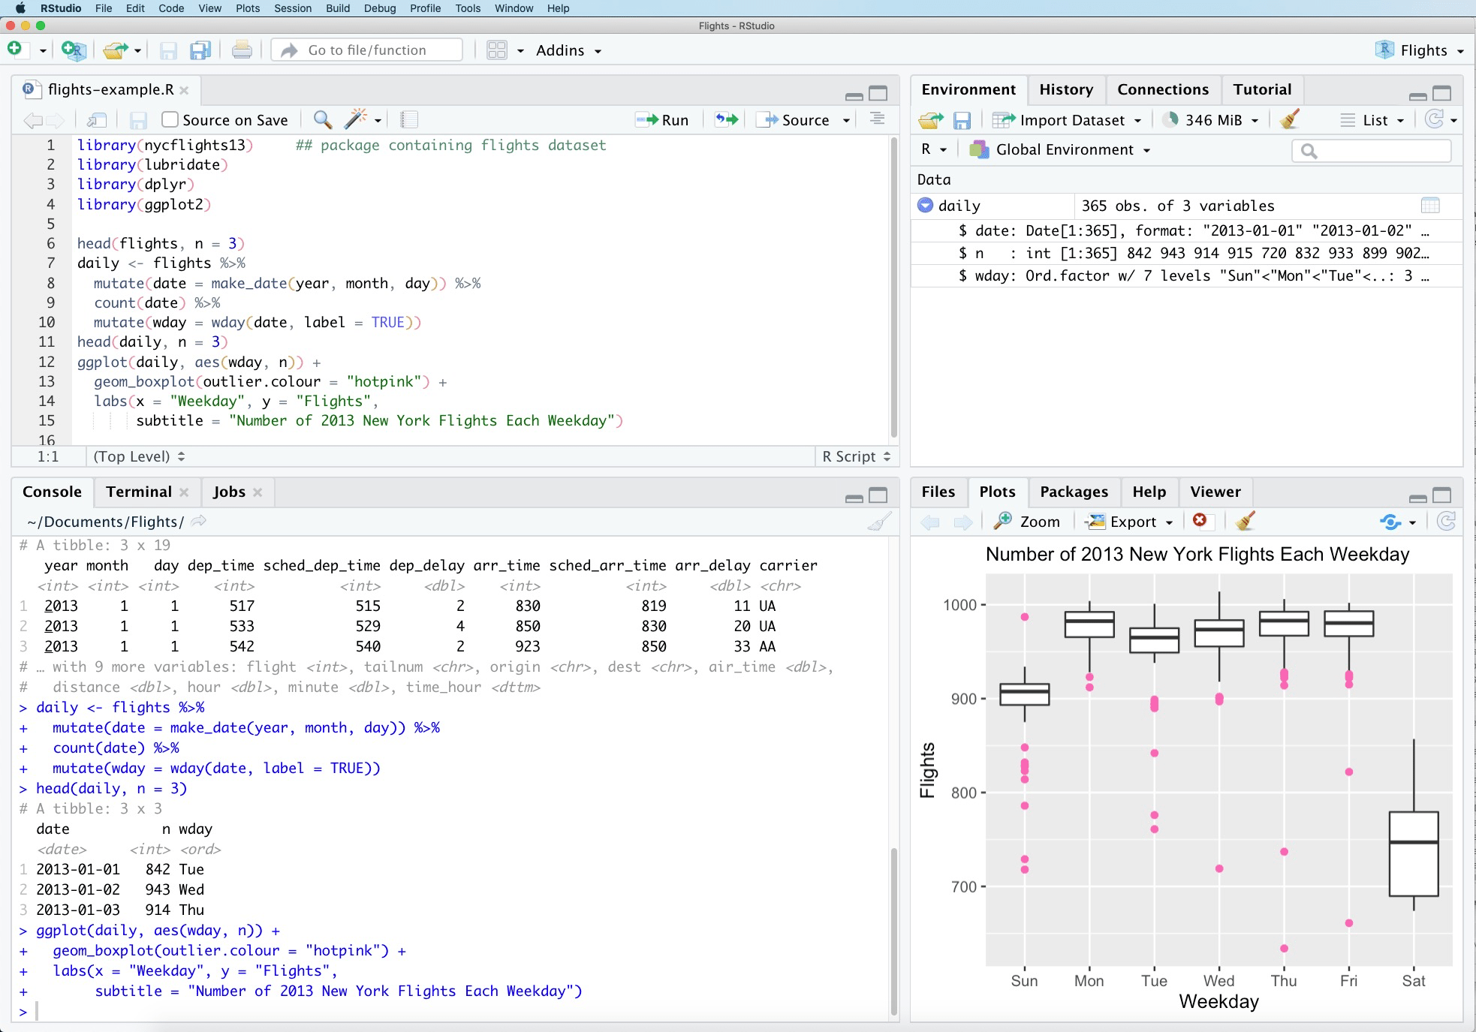
R Studio
R Studio is the integrated development environment (IDE) for working with R
User-friendly interface for writing and debugging R code
Enhances productivity and ease of use

Slide 9
Why use R?

Slide 10
Why use R?
Interoperability
Integrates with other programming languages and tools
Compatibility with Python, SQL, Hadoop, etc.
Facilitates seamless workflow in data science projects
Reproducible processes
Create processes that you can quickly repeat & reproduce results
Tools like R Markdown for creating dynamic documents
Combines code, output, and narrative text
Ensures reproducible research and reports

Slide 11
R resources

Slide 12
R resources: Getting started
Installing R and R Studio
Download R
Download R Studio
R Packages (what’s an R package and how do I install one?)
Short primers from the owners of R Studio

Slide 13
R resources: Great references
A Gentle Introduction to Tidy Statistics in R – Introductory tutorial focusing on stats
R for Data Science – Free online textbook introducing R for data organization, analysis, manipulation, and visualization
Cheat sheets for popular R packages

Slide 14
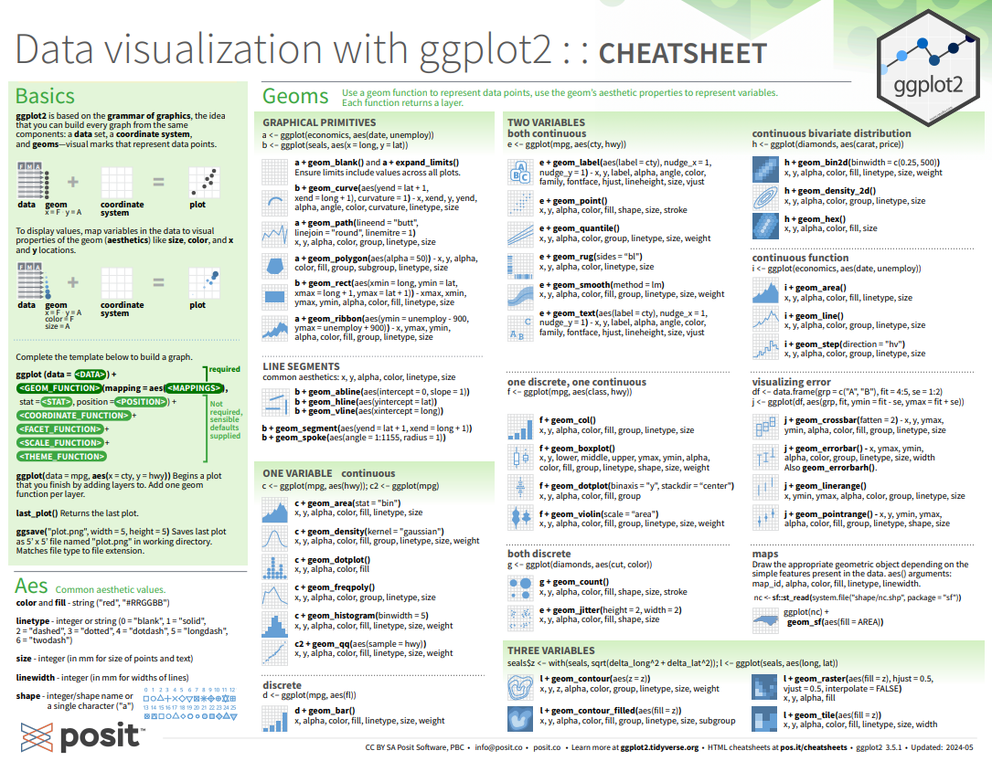

Slide 15
R resources: Fun stuff
R for cats – Fun tutorial about the basics of R programming… with cats!
Learning R – Episode of the PolicyViz podcast with Jonathan Schwabish from the Urban Institute where he talks about his approach to learning R

Slide 16
Discussion

Slide 17
Discussion questions
What R projects have you been working on?
What questions do you have?
What do you want to learn about R?
What would you be willing to demo at a future R meeting?

Slide 18
Demo

Slide 19
Demo
Demo topic: | Cleaning a column with unstandardized town name data
Presenter: | Sarah Hurley and Pauline Zaldonis
Packages used: | dplyr, readr, stringr
Script link: | https://github.com/CTOpenData/r-user-group/blob/main/address_data_cleaning.R

Slide 20
Next steps

Slide 21
See you next time!
Monthly meetings: second Tuesday of each month
July 9
August 13
September 10
October 8
November 12
December 10
Topic for next demo: working with Census data in R

